Slide 1



Terrainosaurus
Terrain Generation
Using Genetic Algorithms
Teong Joo Ong
Ryan Saunders
John Keyser
John Leggett
GECCO 2005
Washington, D.C.
June 24th–30th

Slide 2


Overview
Introduction
Motivation
  Applications of terrain generation
  Current terrain generation methods
  Our goals
  Terrain model representation
The algorithm
  Phase I: Construct a terrain type database
  Phase II: Design the terrain layout
  Phase III: Generate the height field
Discussion
Conclusion

Slide 3
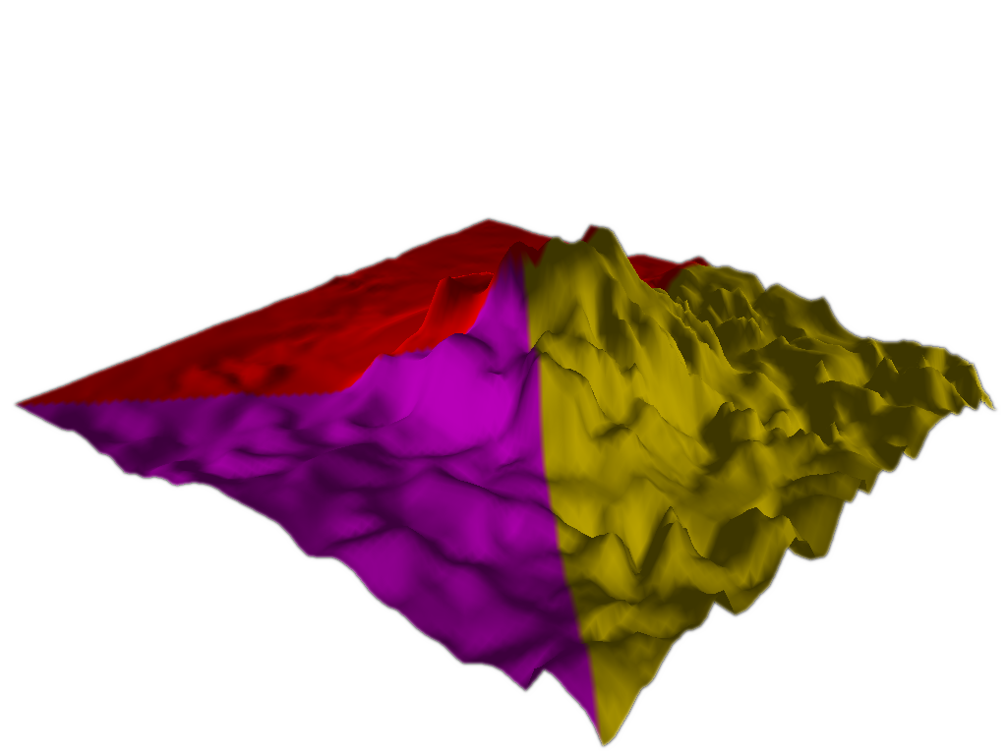
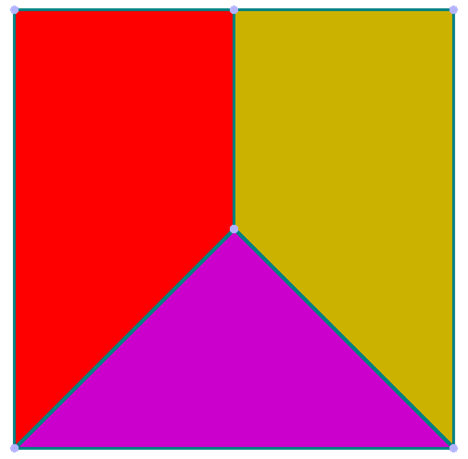


Introduction
What we’re doing
Terrain generation
  Existing methods are limited: too unrealistic, or else too much work
A new way of generating terrain
  User-oriented
  Physically-based
  Extensible
Basic idea: let the user design by example, and let a genetic algorithm do the hard work

Slide 4

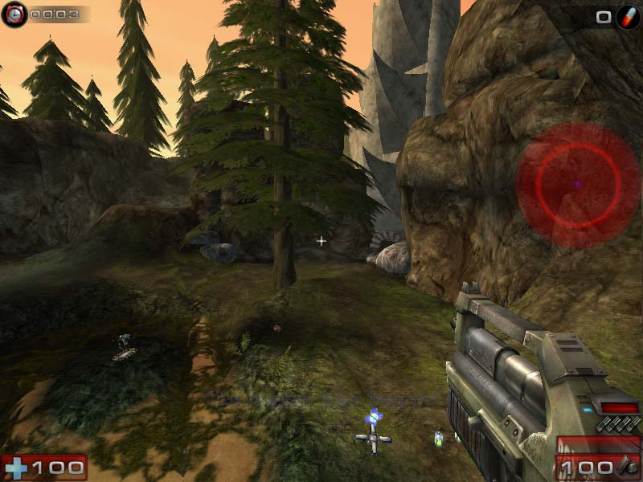
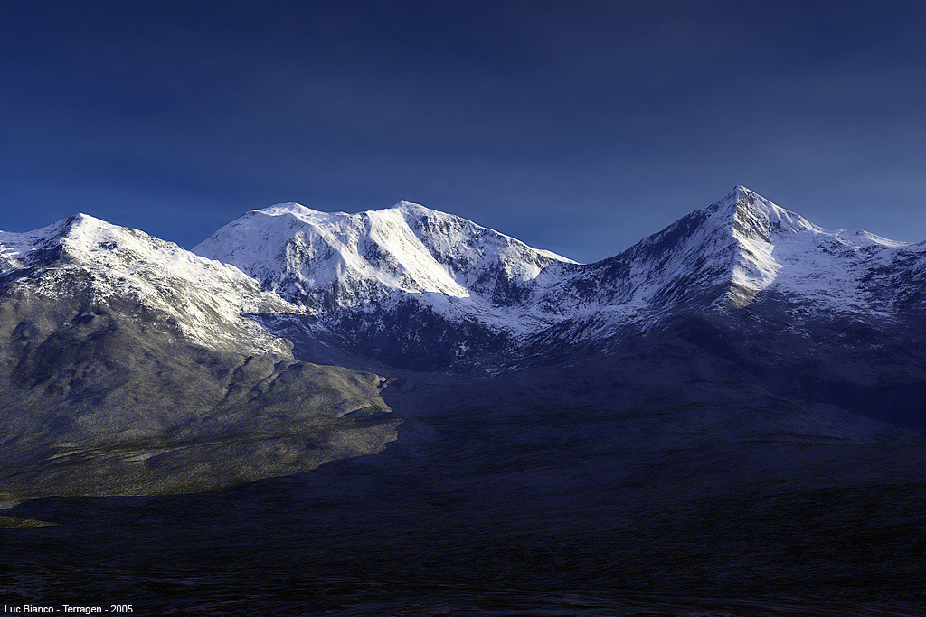
Applications of Terrain Generation
Why would you want to do this?
Art
Architectural rendering
Training exercises
CG movies
Games
1
Images ©:
1. DreamWorks, LLC
2. Epic Games, Inc.
3. Luc Bianco
2
3

Slide 5
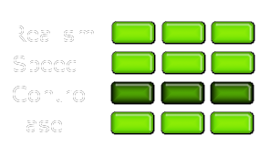
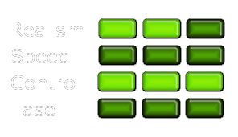
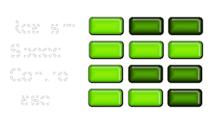
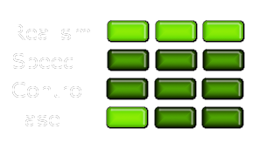
Current Terrain Generation Methods
Strengths & Weaknesses
GIS Data
Sculpting (e.g., Terragen)
Procedural (e.g., fractals)
Simulation (e.g., Erosion3D)

Slide 6
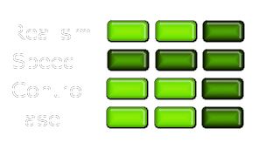
How Terrainosaurus is Different
Where we fit in
Goals of Terrainosaurus
  Realism
  Extensibility
  Ease of use
The result
  More control than fractals
  Less work than sculpting
  Realism approaching GIS
A good solution for non-real-time, authoring applications
Terrainosaurus

Slide 7
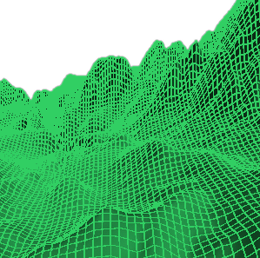
Terrain Model Representation
Height fields are our friends
Height field
  Regular 2D grid of elevations
  Equivalent to grayscale image
Advantages
  Commonly used, easily implemented
  Real-world surveying data available
  Ideal for rendering & collision detection
Disadvantages
  Precludes representation of caves & overhangs

Slide 8
Overview
(again)
Introduction
Motivation
  Applications of terrain generation
  Current terrain generation methods
  Our goals
  Terrain model representation
The algorithm
  Phase I: Construct a terrain type database
  Phase II: Design the terrain layout
  Phase III: Generate the height field
Discussion
Conclusion

Slide 9
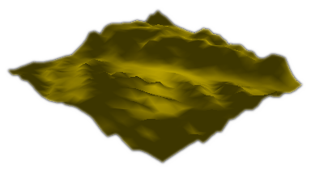
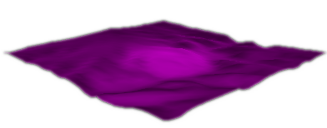

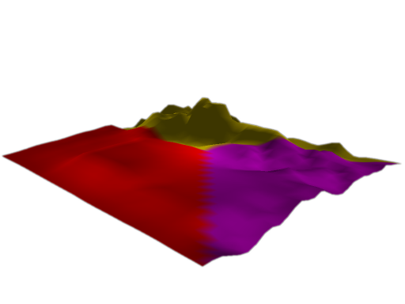
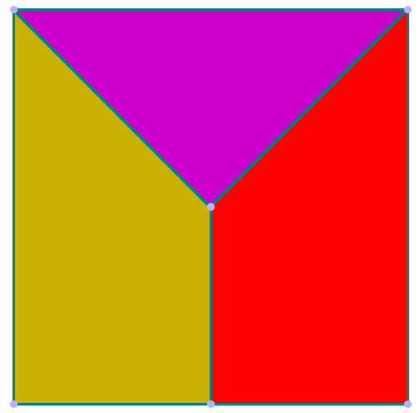
The Algorithm
The Big Picture
User designs terrain using intuitive, low-effort inputs
  Terrain characteristics are specified by example, using real-world GIS terrain data
  The layout of the terrain is created visually, by drawing a “map”
  The GA creates a height field matching these inputs

Slide 10
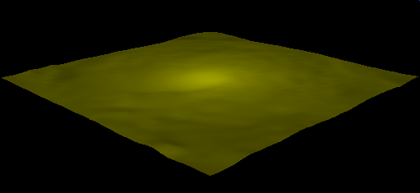
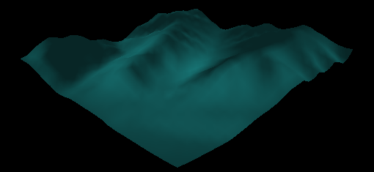
Phase I
Constructing a terrain library
Desert terrain from Texas
Mountain terrain from Washington
The user creates a database of example height fields
  Normally, these are from real-world data from GIS sources
  He classifies them into logical terrain types (e.g., “desert”)
  This forms the user’s “palette” of terrain

Slide 11
Phase II
Laying out the terrain
Utah Foothills
Most of the user’s work is done here, designing the terrain
This is done visually, with a CAD-style interface, a la Maya or AutoCAD
The user sketches his design as a “map” of 2D polygonal terrain regions
Each region is assigned a terrain type
Texas Desert
Wyoming Mountains

Slide 12


Phase II
Refining region boundaries
Polygonal shapes are useful for rapid design, but are not natural
  Occasionally apparent in the generated geometry
  Painfully obvious when texturing or coloring is applied
But making irregular shapes by hand is tedious!
Thus, we provide a boundary refinement operation

Slide 13
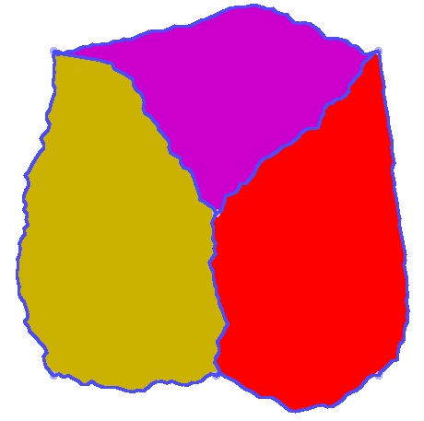
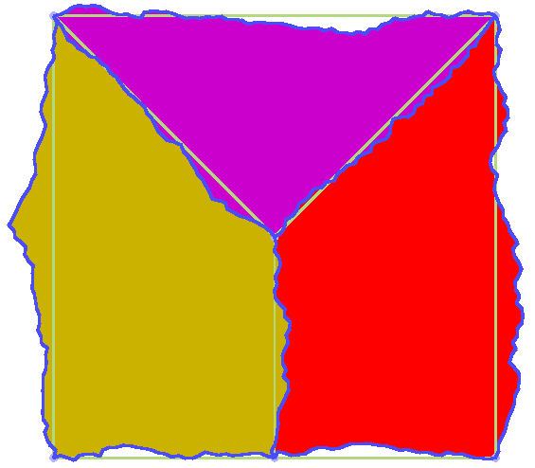
Phase II
Refining region boundaries
The refinement operation
  Essentially, randomized subdivision
  Desired shape controlled by a smoothness parameter
Results with different
smoothness values

Slide 14

Phase II
Encoding a boundary
A boundary is
  Logically, a series of 2D Cartesian points
  Encoded as a series of relative angles between segments
    α ∈ [ -π, π ] → ƒ ∈ [-1,1]
This form is convenient for performing mutations and crossover

Slide 15
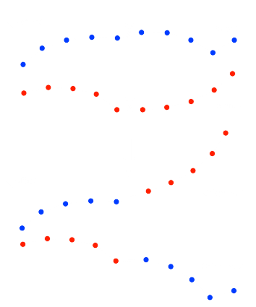
Phase II
The crossover operator
Genetic exchange is done with a standard crossover operator
This is equivalent to cutting and splicing the world-space boundaries

Slide 16
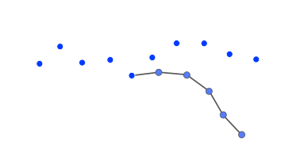
Phase II
The mutation operator
Mutation is also done with a standard operator
This is equivalent to randomly “bending” the boundary at one of the points

Slide 17
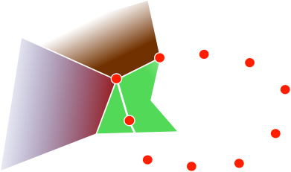
Phase II
Preventing unreasonable results
One problem that arises with this scheme is that the boundary can “double back” on itself
If this happens, the boundary will be badly scaled
We solve this by imposing a global limit on the absolute angle

Slide 18
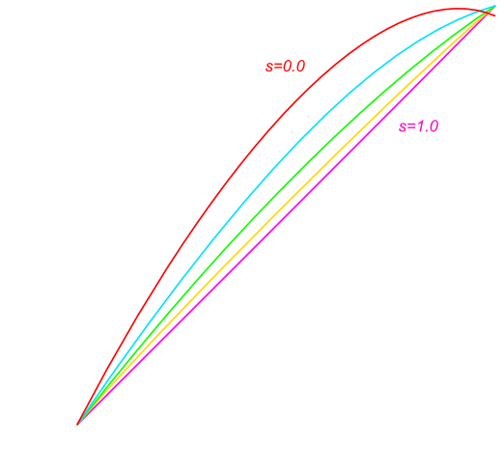
Phase II
The fitness evaluation
The fitness of a candidate boundary is found by averaging the smoothness of all of the genes

Slide 19
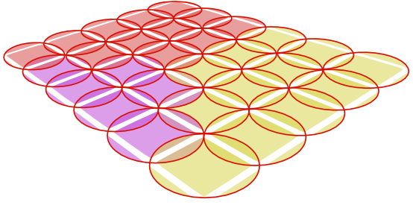
Phase III
Encoding a height field (cont’d)
The genes are arranged into a 2D grid
Each gene is responsible for a small region of the height field (e.g., 16x16 pixels)
The height field can be reconstituted by blending together the genes’ data

Slide 20
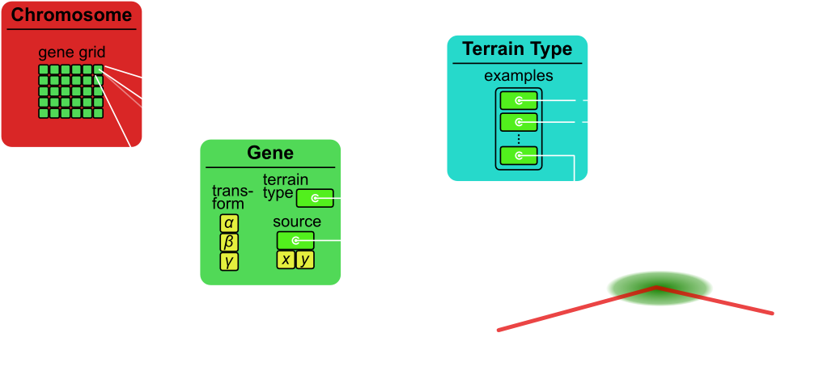
Phase III
Encoding a height field (cont’d)
Each gene encodes the image processing instructions to reconstruct its part of the height field:
  A pointer into one of the examples for its terrain type (source data)
  A set of transformation parameters

Slide 21
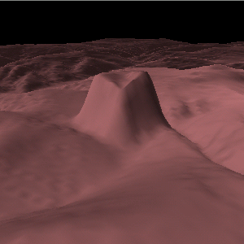
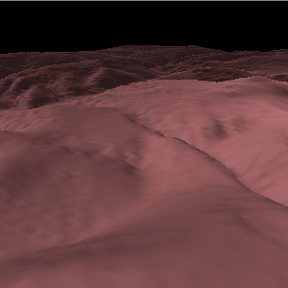
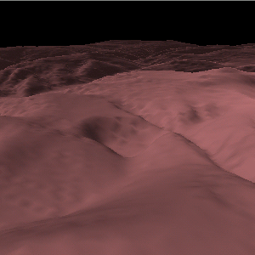
Phase III
Crossover & mutation operators
The crossover operator copies rectangular blocks of adjacent genes
Mutation operators alter the transformation parameters for a gene, or select new source data
  Inexpensive, local modifications to the terrain structure
vertical offset mutation
original
rotate mutation

Slide 22
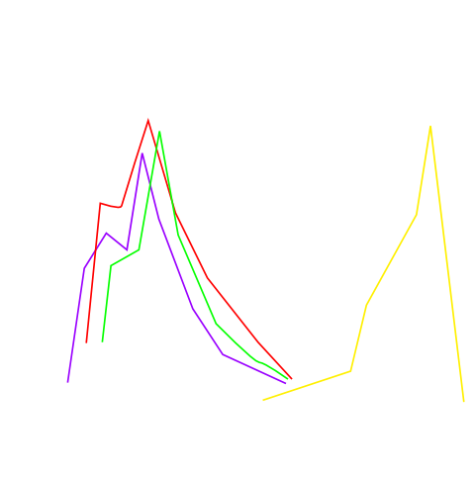

Phase III
Terrain type similarity for a region
Discriminating “good” and “bad” terrain
  Estimate the degree of similarity between statistical distributions
    Elevation
    Slope
    Length/scale of edges
    Etc.

Slide 23
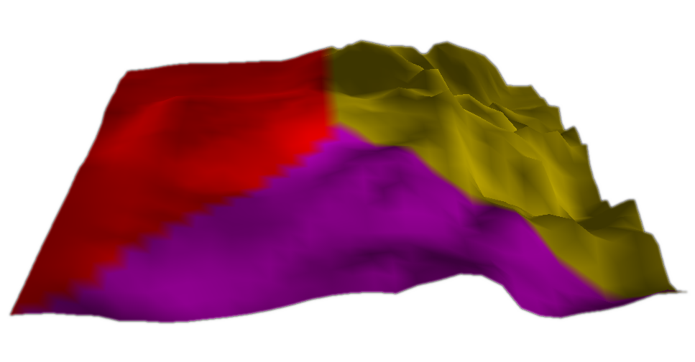
Discussion
What worked…what didn’t
It is fairly successful at reproducing some kinds of terrain (especially flatter ones)
Transitions between terrain types work well
Scalability is a problem for the height field GA
  Fitness evaluation is costly
  The problem size grows with the level of detail…and thus, so must the population size

Slide 24

Conclusion
Terrainosaurus
  User-friendly method of generating terrain
  Physically-based
  Offloads generation process from user to GA
Future work
  Improved height field fitness evaluation
  Feature-level authoring & construction

Slide 25
Contact
Ryan Saunders
rls@tamu.edu
Questions?
Thanks to:
NSF grant NSF-CCR-00000
Texas A&M University
Dept. of Computer Science
Geometry & Graphics Group

